Slide 1
TEXT TO IMAGE GENERATION

Slide 2
Table of content
INTRODUCTION
GENERATIVE MODELS
OUR MODEL
RESULTS
OPTIMIZATION
REFERENCES

Slide 3
INTRODUCTION

Slide 4
Introduction
Problem definition
Objective
application

Slide 5
GENERATIVE MODELS

Slide 6
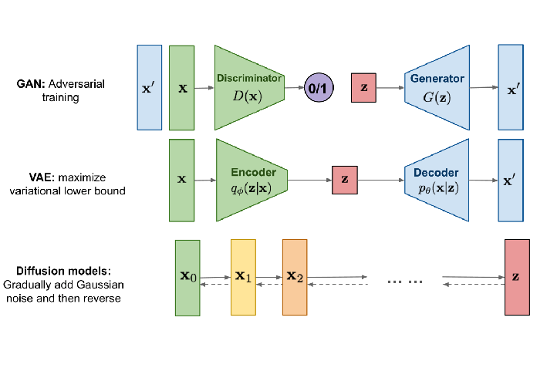
GENERATIVE MODELS
https://lilianweng.github.io/posts/2021-07-11-diffusion-models/

Slide 7
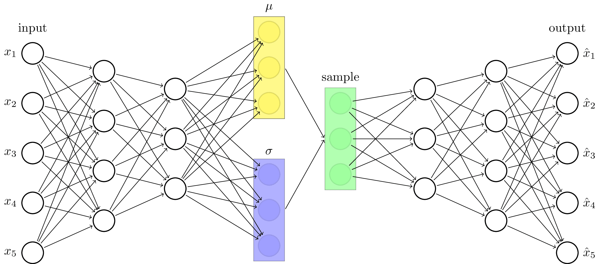
Variational Autoencoders (VAEs)
https://tikz.net/vae/

Slide 8
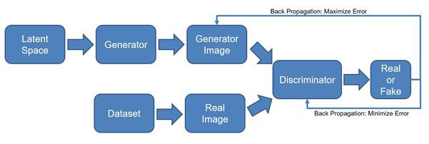
Generative Adversarial Networks (GAN)
https://turcomat.org/index.php/turkbilmat/article/download/5936/4939/10969

Slide 9
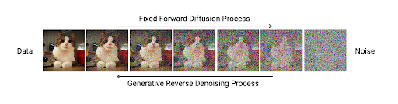
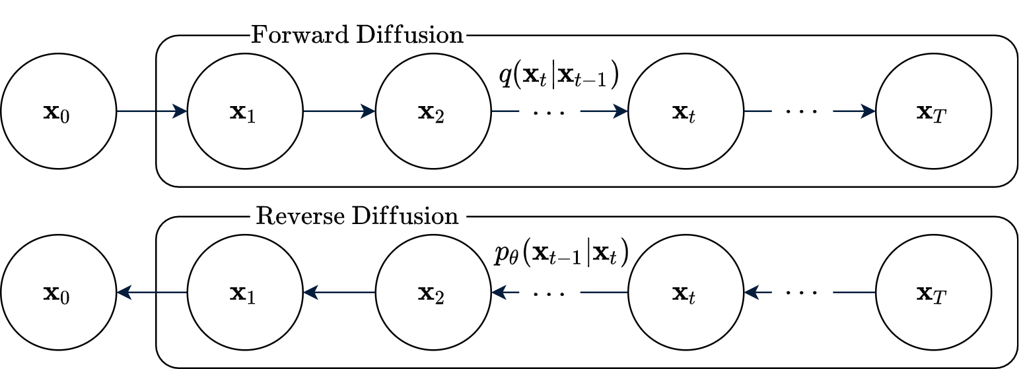
Score-Based Generative Model (Diffusion Model)
https://developer.nvidia.com/blog/improving-diffusion-models-as-an-alternative-to-gans-part-1/

Slide 10
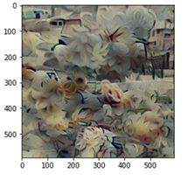
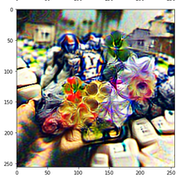
أزهار جميلة (imagenet_f16-16384)
Before
After

Slide 11
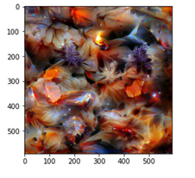
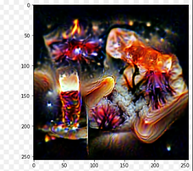
cosmic crystals of jelly and fire flowers (imagenet_f16-16384)
Before
After

Slide 12
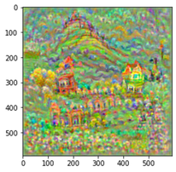
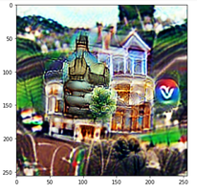
Victorian house on hill (sflckr)
Before
After

Slide 13
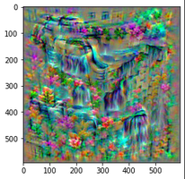
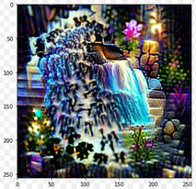
beautiful waterfall (sflckr)
Before
After

Slide 14
OUR MODEL
VQGAN
TAMING TRANSFORMER
CLIP
SENTENCE BERT

Slide 15
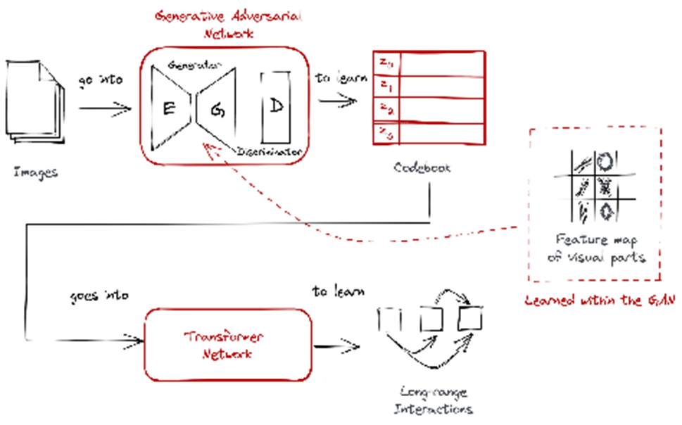
VQGAN
VQGAN express images through a codebook: A codebook obtained via vector quantization.
Vector quantization is a signal processing technique for encoding vectors.
It consists of codewords that allows us to easily train a transformer on top of it.
https://ljvmiranda921.github.io/notebook/2021/08/08/clip-vqgan/#ballard1999vq

Slide 16
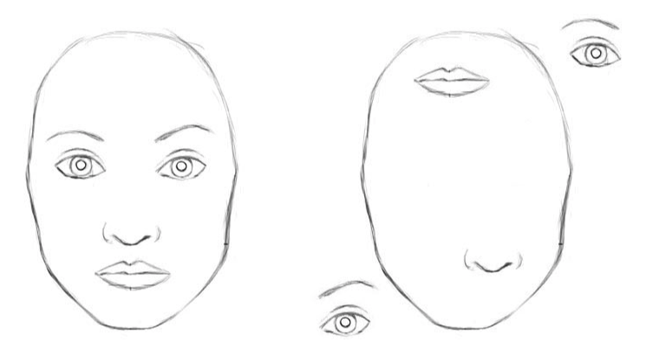
TAMING TRANSFORMER
FROM CNN TO TRANSFORMER
FROM TRANSFORMER TO TAMING TRANSFORMER
Disadvantage of CNN
local interaction and not encode the relative position of different features.
Advantage of transformer
learn complex relationship between inputs
Disadvantages of Transformer
computationally cost increasing quadratically
low resolution
Advantage of taming transformer
represent image by codebook not pixel like transformer

Slide 17
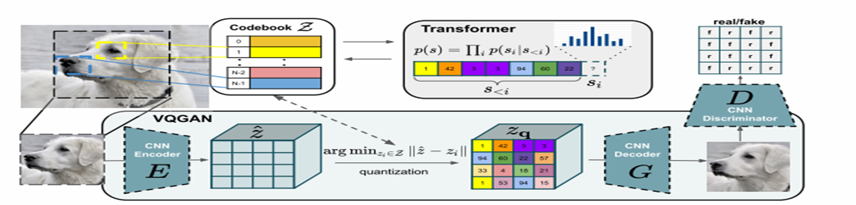
TAMING TRANSFORMER
This is a two-step training architecture design:
Training the VQ-GAN and learning the quantized codebook.
Training an autoregressive transformer using the quantized codebook as sequential input to the transformer
https://arxiv.org/abs/2012.09841

Slide 18
TRAINING VQ_GAN
Loss VQ
reconstruction loss
commitment loss
Loss GAN
Total loss

Slide 19
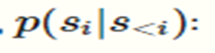
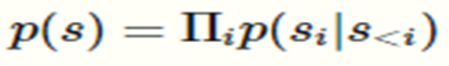
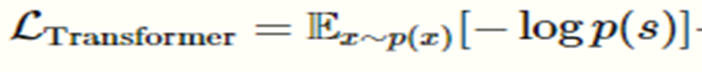
TRAINING TRANSFORMER
Transformer learns to predict the distribution of possible next indices
to compute the likelihood of the full representation as
this allows us to directly maximize the log-likelihood of the data
representations.
L_transformer :

Slide 20
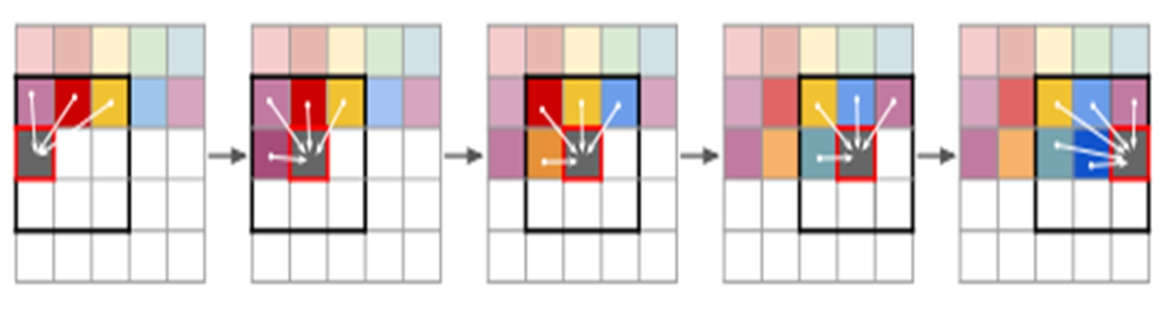
TAMING TRANSFORMER USING SLIDING WINDOW
To generate high-resolution images and reduce computational cost, sliding attention can be used instead of full attention.
https://arxiv.org/abs/2012.09841

Slide 21
CLIP
CLIP (Contrastive Language-Image Pre-Training) is a neural network trained on 400,000,000 (image, text) pairs.
You can input an image into the CLIP model, and it will return for you the likeliest caption or summary of that image.

Slide 22
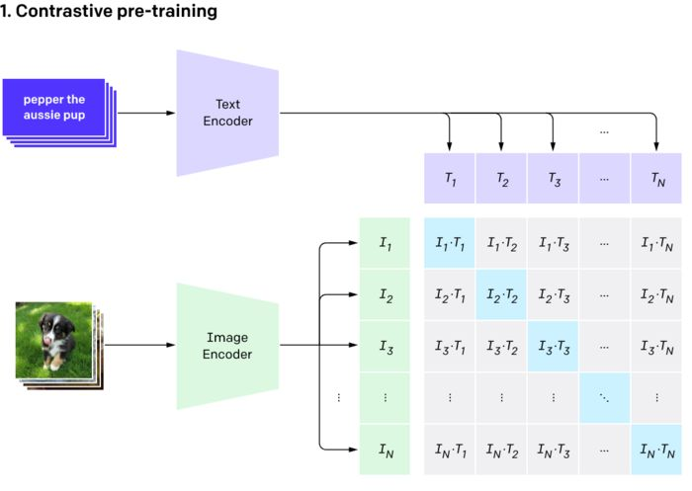
CLIP APPROACH
https://arxiv.org/abs/2103.00020

Slide 23
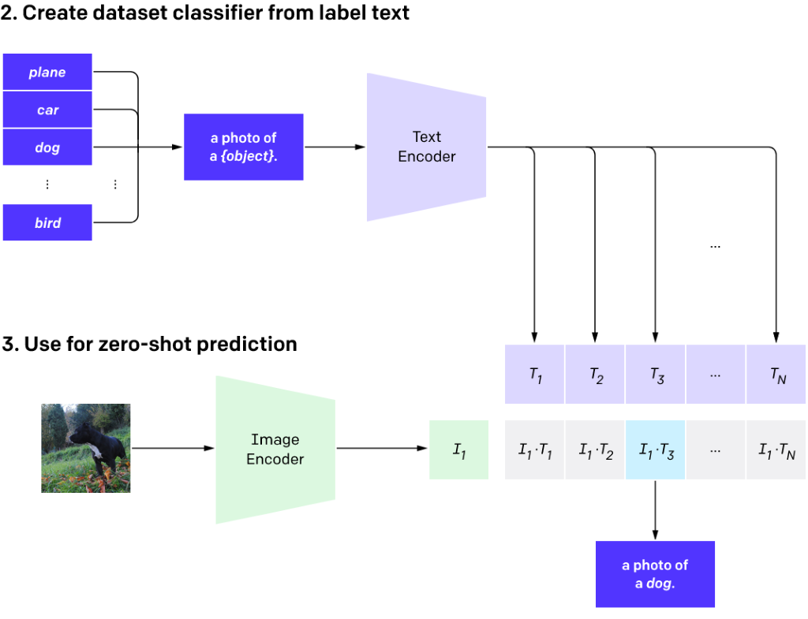
CLIP APPROACH
https://arxiv.org/abs/2103.00020

Slide 24
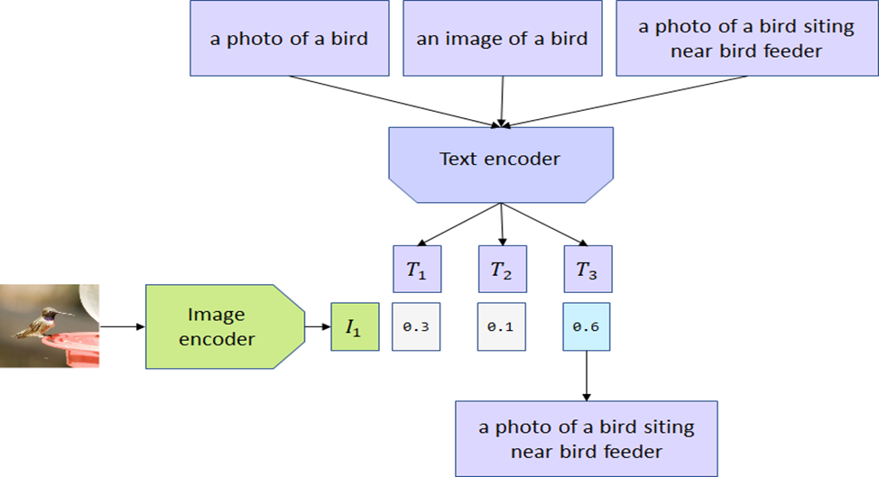
CLIP APPROACH
https://habr.com/en/post/537334/

Slide 25
ADVANTAGES OF CLIP
Generalizability
Connecting text / images
Good performance with (classification, image feature utilization) .
Act as a classifier
Labeled data

Slide 26
Summary of our model
VQGAN MODEL +CLIP MODEL
VQGAN MODEL FROM TAMING TRANSFORMER (GUMBEL_F8-8192)
IMAGE ENCODER FROM CLIP (VIT-B/32)
TEXT ENCODER FROM CLIP (VIT-B-32-MULTILANGUAL)
AFTER NUMER OF ITERATIONS IT RETURNS IMAGE WHICH EXPRESSES TEXT

Slide 27
SBERT
SentenceTransformers can be used to map images and texts to the same vector space.
The model uses the OpenAI CLIP Model, which was trained on a large set of images and image alt texts.
The original CLIP Model only works for English, hence, we used Multilingual Knowledge Distillation to make this model work with 50+ languages.

Slide 28
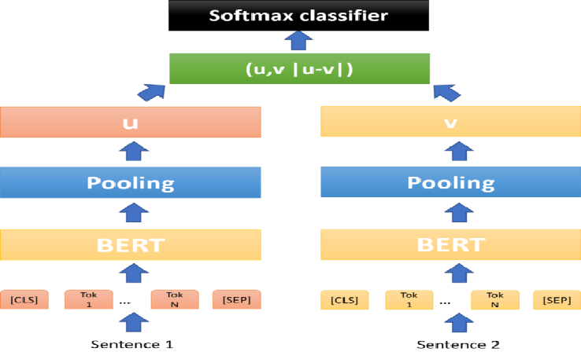
SBERT
https://arxiv.org/abs/1908.10084?fbclid=IwAR1SuKFErSs-2wS4YsY0fSdP1di-RyWPjyFX91loT-2NkdSdBklAgB_q0-M

Slide 29
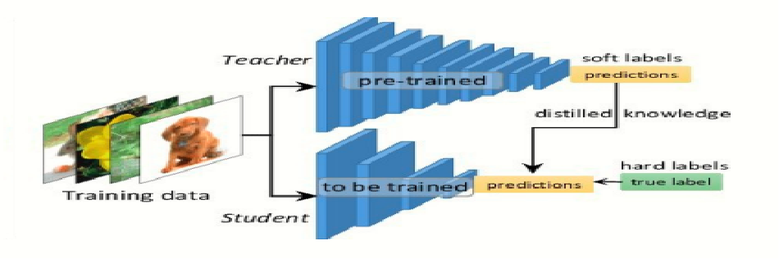
SBERT
https://arxiv.org/abs/1908.10084?fbclid=IwAR1SuKFErSs-2wS4YsY0fSdP1di-RyWPjyFX91loT-2NkdSdBklAgB_q0-M

Slide 30
IMPLMENTATION

Slide 31
Implementation
Programming language
DataSet
Python in implementation
Create user interface with streamlit
Vqgan model trained on gumbel data set
metric
Our metric will divide to two evaluations:
Objective evaluation: evaluation by guides the model though CLIP –score.
Subjective evaluation: human evaluation through user evaluation.

Slide 32
RESULTS

Slide 33
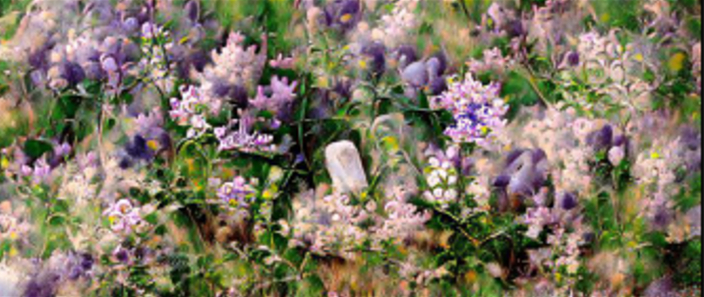
Wildflowers in Lilac

Slide 34
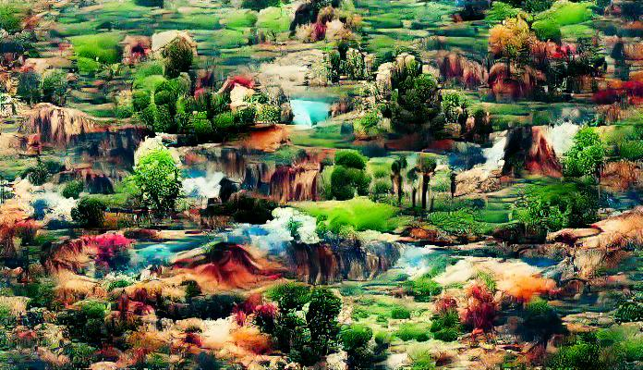
Landscape is beautiful

Slide 35
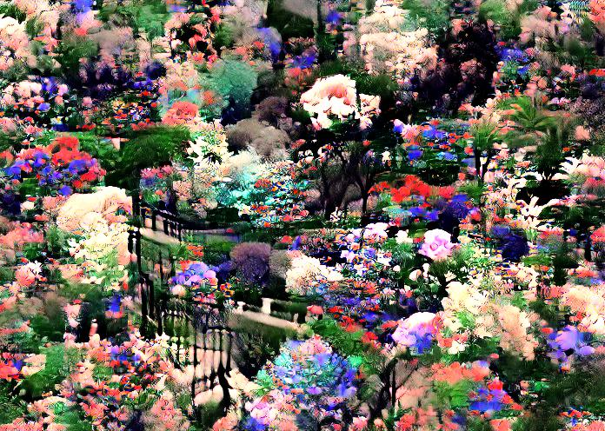
حدائق بزهور جميلة

Slide 36
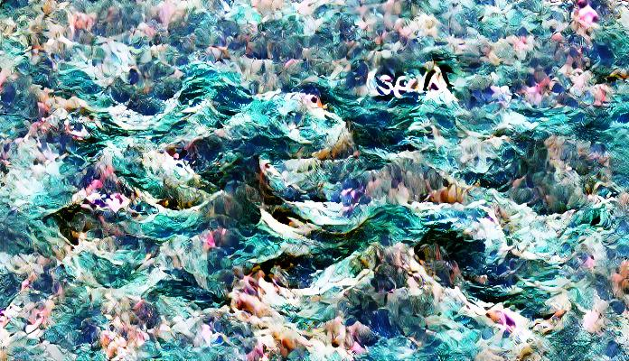
Sea

Slide 37
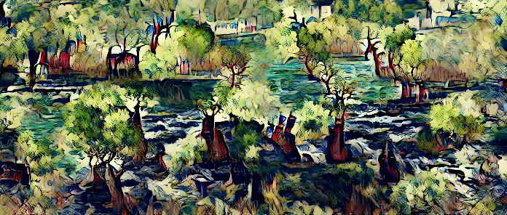
Tree by the river

Slide 38
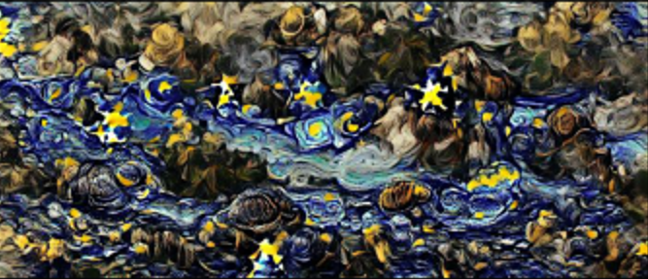
The Starry Night

Slide 39
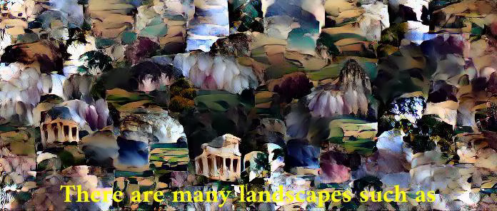
There are many landscapes such as, small waterfalls, forests, seas, birds in the sky, flowers in gardens, tall trees.

Slide 40
OPTMIZATION

Slide 41
REFERENCES

Slide 42
REFERENCES
A beginner's guide to the clip model. KDnuggets. (n.d.). Retrieved March 5, 2022, from https://www.kdnuggets.com/2021/03/beginners-guide-clip-model.html
Conneau, A., Khandelwal, K., Goyal, N., Chaudhary, V., Wenzek, G., Guzmán, F., ... & Stoyanov, V. (2019). Unsupervised cross-lingual representation learning at scale. arXiv preprint arXiv:1911.02116.
Daniel Nelson. (2020, October 5). What is a Generative Adversarial Network (GAN)?]. Retrieved from https://www.unite.ai/what-is-a-generative-adversarial-network-gan/
Devlin, J., Chang, M. W., Lee, K., & Toutanova, K. (2018). Bert: Pre-training of deep bidirectional transformers for language understanding. arXiv preprint arXiv:1810.04805.
Esser, Patrick & Rombach, Robin & Ommer, Björn. (2020). Taming Transformers for High-Resolution Image Synthesis.
Frolov, V. (2021, January 14). Clip from OpenAI: What is it and how you can try it out yourself. Хабр. Retrieved March 6, 2022, from https://habr.com/ru/post/537334/
Jakub Langr and Vladimir Bok (September 2019). GANs in Action: Deep learning with Generative Adversarial Network.
Liu, Y., Ott, M., Goyal, N., Du, J., Joshi, M., Chen, D., ... & Stoyanov, V. (2019). Roberta: A robustly optimized Bert pretraining approach. arXiv preprint arXiv:1907.11692.

Slide 43
REFERENCES
Nils Reimers, Iryna Gurevych (2019). Sentence-BERT: Sentence Embeddings using Siamese BERT-Networks. DOI: https://arxiv.org/abs/1908.10084
Reimers, N., & Gurevych, I. (2019). Sentence-Bert: Sentence embeddings using siamese Bert-networks. arXiv preprint arXiv:1908.10084
Sergios Karagiannakos. (2022, March 3). Vision language models: Towards multi-modal Deep learning. AI Summer. Retrieved March 6, 2022, from https://theaisummer.com/vision-language-models/
Shariatnia, M. (2021, April 7). Simple implementation of OpenAI Clip Model: A tutorial. Medium. Retrieved March 6, 2022, from https://towardsdatascience.com/simple-implementation-of-openai-clip-model-a-tutorial-ace6ff01d9f2
Pires, T., Schlinger, E., & Garrette, D. (2019). How multilingual is multilingual BERT? arXiv preprint arXiv:1906.01502.
Yang, Y., Cer, D., Ahmad, A., Guo, M., Law, J., Constant, N., ... & Kurzweil, R. (2019). Multilingual universal sentence encoder for semantic retrieval. arXiv preprint arXiv:1907.04307.
What are Diffusion Models? Lilian Weng. Retrieved July 11, 2021, from https://lilianweng.github.io/posts/2021-07-11-diffusion-models/
Generative Modeling by Estimating Gradients of the Data Distribution. Yang Song. Retrieved May 5, 2021 , from
https://yang-song.github.io/blog/2021/score/

Slide 44
REFERENCES
Diffusion Models Made Easy . J. Rafid Siddiqui, PhD. Retrieved May 2, 2022 , from https://towardsdatascience.com/diffusion-models-made-easy-8414298ce4da
Improving Diffusion Models as an Alternative To GANs, Part 1. Arash Vahdat and Karsten Kreis. Retrieved Apr 26, 2022, from
https://developer.nvidia.com/blog/improving-diffusion-models-as-an-alternative-to-gans-part-1/
Improving Diffusion Models as an Alternative To GANs, Part 2. Arash Vahdat and Karsten Kreis. Retrieved Apr 26, 2022, from https://developer.nvidia.com/blog/improving-diffusion-models-as-an-alternative-to-gans-part-2/
Introduction to autoencoders. JEREMY JORDAN. Retrieved MAR 19, 2018, from https://www.jeremyjordan.me/autoencoders/
Intuitively Understanding Variational Autoencoders. Irhum Shafkat. Retrieved Feb 4, 2018, from https://towardsdatascience.com/intuitively-understanding-variational-autoencoders-1bfe67eb5daf
Flow-based Deep Generative Models. Lilian Weng. Retrieved October 13, 2018, from
https://lilianweng.github.io/posts/2018-10-13-flow-models/

